Slide 1
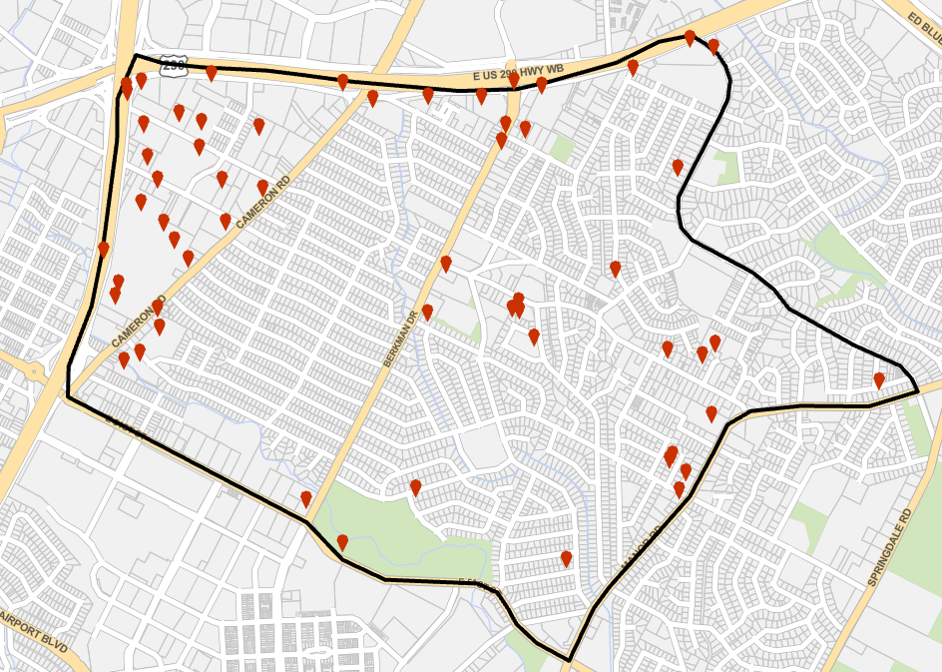
Windsor Park Neighborhood
Crimes Against Persons
2024
Month | Total
Jan | 20
Feb | 30
Mar | 22
Apr | 28
Total | 100
NIBRs Offense | Total
13B Simple Assault | 43
13C Intimidation | 36
13A Aggravated Assault | 17
11D Fondling | 2
11A Rape | 1
09A Homicide | 1
Total | 100
Day | Total
Sun | 12
Mon | 21
Tue | 10
Wed | 22
Thu | 11
Fri | 12
Sat | 12
Total | 100
Family Violence | Total
N | 67
Y | 33
Total | 100
Victim Sex | Total
Female | 56
Male | 42
Unknown | 2
Total | 100
2 Stabbings
Analyst Comment: No identifiable hotspot for Crimes Against Persons committed in the first four months of 2024 could be detected. This is likely due to the lack of density versus the number of crimes committed.
Homicide
Incident

Slide 2
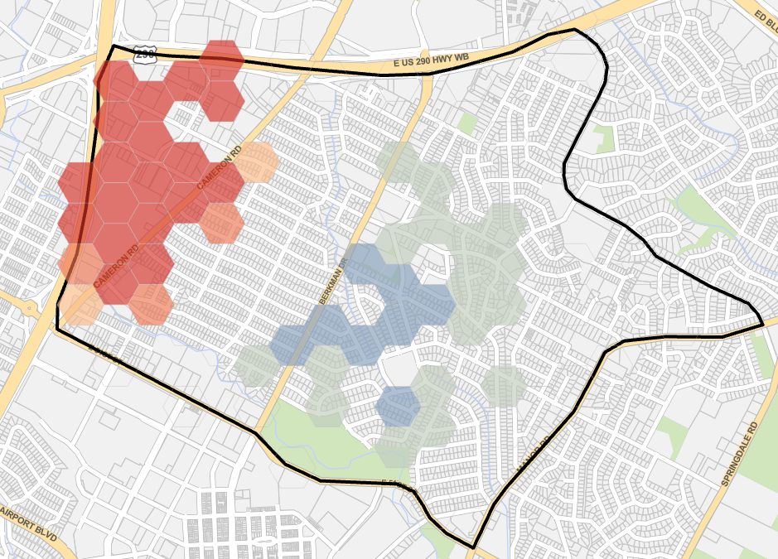
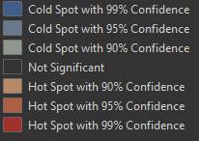
Windsor Park Neighborhood
Crimes Against Property
2024
Day | Total
Sun | 44
Mon | 35
Tue | 45
Wed | 40
Thu | 33
Fri | 38
Sat | 29
Total | 264
Month | Total
Jan | 70
Feb | 66
Mar | 64
Apr | 64
Total | 264
NIBRs Group | Total
Larceny/Theft Offenses | 124
Destruction/Damage/Vandalism of Property | 42
Motor Vehicle Theft | 34
Burglary/Breaking & Entering | 29
Fraud Offenses | 19
Robbery | 12
Counterfeiting/Forgery | 3
Arson | 1
Total | 264

Slide 3
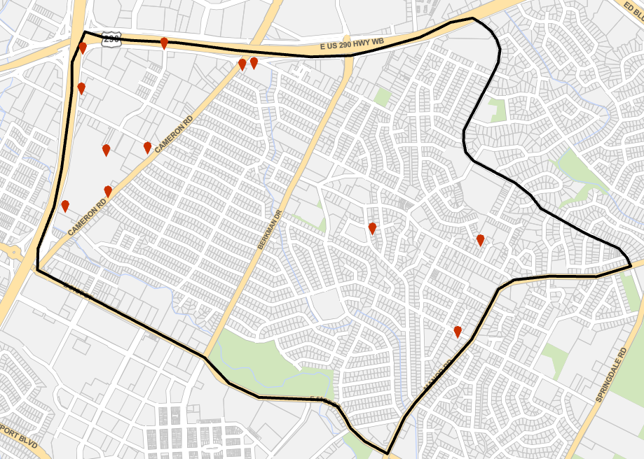
Windsor Park Neighborhood
Robbery
2024
Day | Total
Sun | 1
Mon | 4
Tue | 2
Thu | 3
Fri | 1
Sat | 1
Total | 12
Month | Total
Jan | 3
Feb | 3
Mar | 3
Apr | 3
Total | 12
Location | Total
PARKING /DROP LOT/ GARAGE | 6
CONVENIENCE STORE | 2
SERVICE/ GAS STATION | 1
SPECIALTY STORE | 1
AIR / BUS / TRAIN TERMINAL | 1
DEPARTMENT / DISCOUNT STORE | 1
Total | 12
Incident

Slide 4
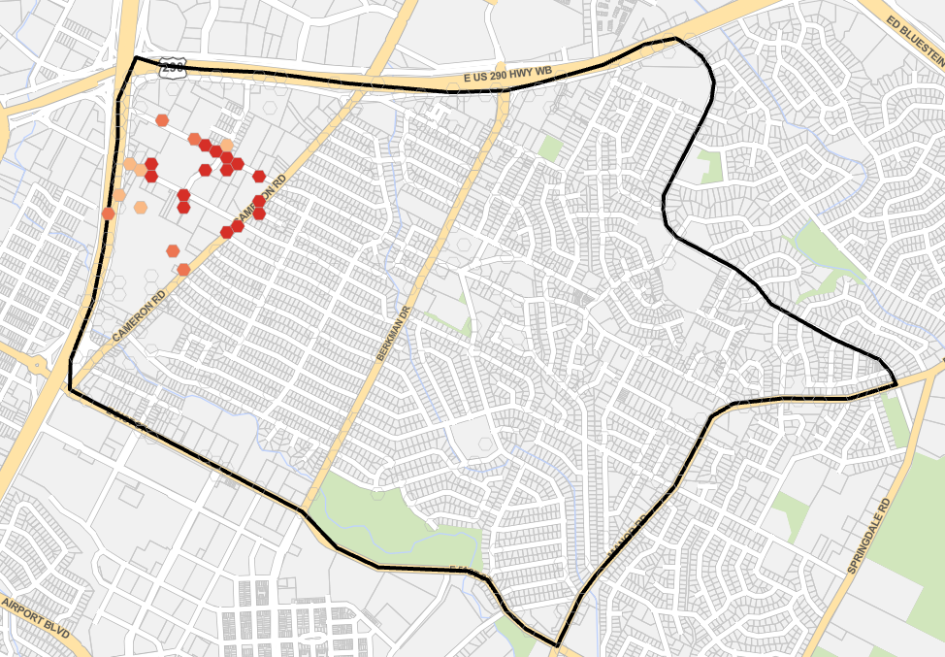
Windsor Park Neighborhood
Calls for Service
2024
Day | Total
Sun | 282
Mon | 312
Tue | 247
Wed | 295
Thu | 272
Fri | 292
Sat | 270
Total | 1970
Month | Total
Jan | 458
Feb | 443
Mar | 565
Apr | 504
Total | 1970
Top 10 Initial Call Problems | Total
Trespass Urgent | 272
Disturbance Other | 179
Suspicious Person | 150
Alarm Burglar | 126
Check Welfare Urgent | 121
DOC / C.O. Violation | 109
Disturbance HS | 89
Check Welfare Service | 87
Nature Unknown Urgent | 80
Disturbance Urgent | 53
Avg Response Time
0:37:00

Slide 5
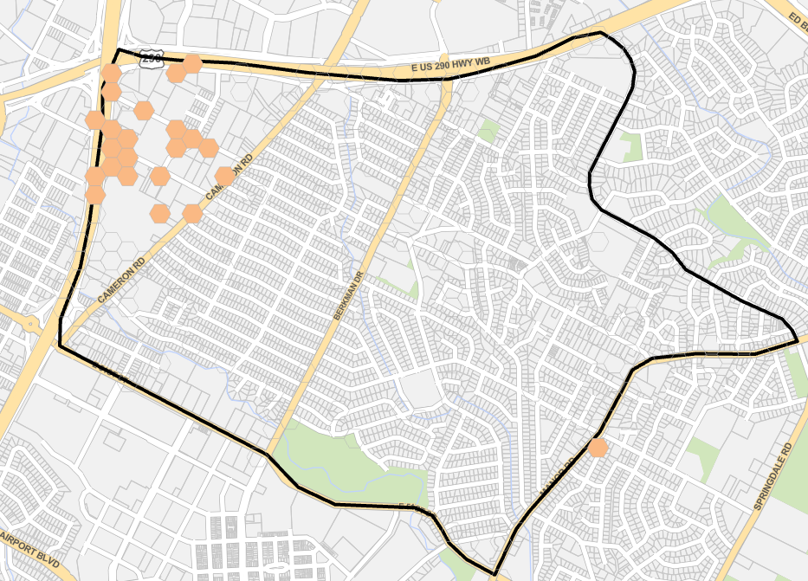
Windsor Park Neighborhood
P0/P1 Calls for Service
2024
Day | Total
Sun | 98
Mon | 89
Tue | 77
Wed | 70
Thu | 94
Fri | 88
Sat | 89
Total | 605
Month | Total
Jan | 118
Feb | 134
Mar | 184
Apr | 169
Total | 605
Top 10 P0/P1 Initial Call Problem | Total
Check Welfare Urgent | 108
Disturbance HS | 86
Nature Unknown Urgent | 71
Disturbance Urgent | 43
Shots Fired | 35
Disturbance Other | 24
Pedestrian on HSR | 19
Crash HS | 19
Traffic Hazard HS | 18
Burglary HS | 18
Avg Response Time
0:11:35

Slide 6
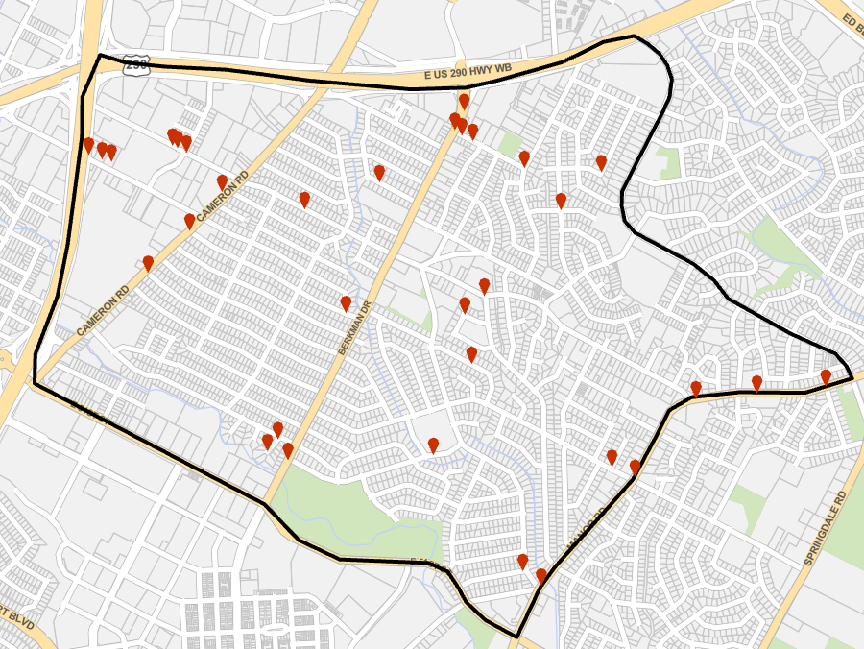
Windsor Park Neighborhood
Shots Fired
2024
Month | Total
Jan | 8
Feb | 9
Mar | 15
Apr | 9
Total | 41
Hour/Day | Sun | Mon | Tue | Wed | Thu | Fri | Sat | Total
00 | 1 | 1 |  |  |  |  | 1 | 3
01 | 1 |  |  |  |  |  | 3 | 4
02 |  | 1 |  |  | 1 | 1 | 2 | 5
03 | 2 |  |  |  | 1 |  |  | 3
04 |  |  | 1 |  |  |  |  | 1
05 | 1 |  |  |  |  |  |  | 1
06 | 2 |  |  |  |  |  | 1 | 3
07 |  |  |  |  |  |  |  | 0
08 |  |  |  |  |  |  |  | 0
09 |  |  |  |  |  |  |  | 0
10 |  |  |  |  |  |  |  | 0
11 |  |  | 1 |  |  |  | 1 | 2
12 |  |  |  |  |  |  |  | 0
13 |  |  |  |  |  |  |  | 0
14 | 1 | 1 |  |  |  |  |  | 2
15 |  |  |  |  |  |  |  | 0
16 |  |  |  |  |  |  |  | 0
17 |  |  |  |  |  | 1 |  | 1
18 |  |  | 1 |  |  |  |  | 1
19 |  |  |  |  | 1 |  |  | 1
20 | 1 |  |  |  |  |  | 2 | 3
21 |  |  |  | 1 |  |  | 1 | 2
22 | 2 |  |  |  | 1 |  |  | 3
23 | 3 |  |  |  | 1 | 1 | 1 | 6
Total | 14 | 3 | 3 | 1 | 5 | 3 | 12 | 41
Avg Response Time
00:07:41
Incident
Analyst Comment: Not enough points to utilize the Optimized Hotspot Analysis Tool.

Slide 7
AUSTIN POLICE DEPARTMENT DATA DISCLAIMER
Understanding the following conditions will allow you to get the most out of the data provided:
Data from CAD is based on a monthly download.
This data includes the record for the PRIMARY unit responding to the incident.
This data includes both self initiated and dispatched calls for service.
Due to methodological differences in data collection, different data sources may produce different results.
The Austin Police Department does not assume any liability for any decision made or action taken or not by the recipient in reliance upon any information or data provided.
The data provided is for informational use only and is not considered official APD crime data as in official Texas DPS or FBI crime reports.

